Slide 1
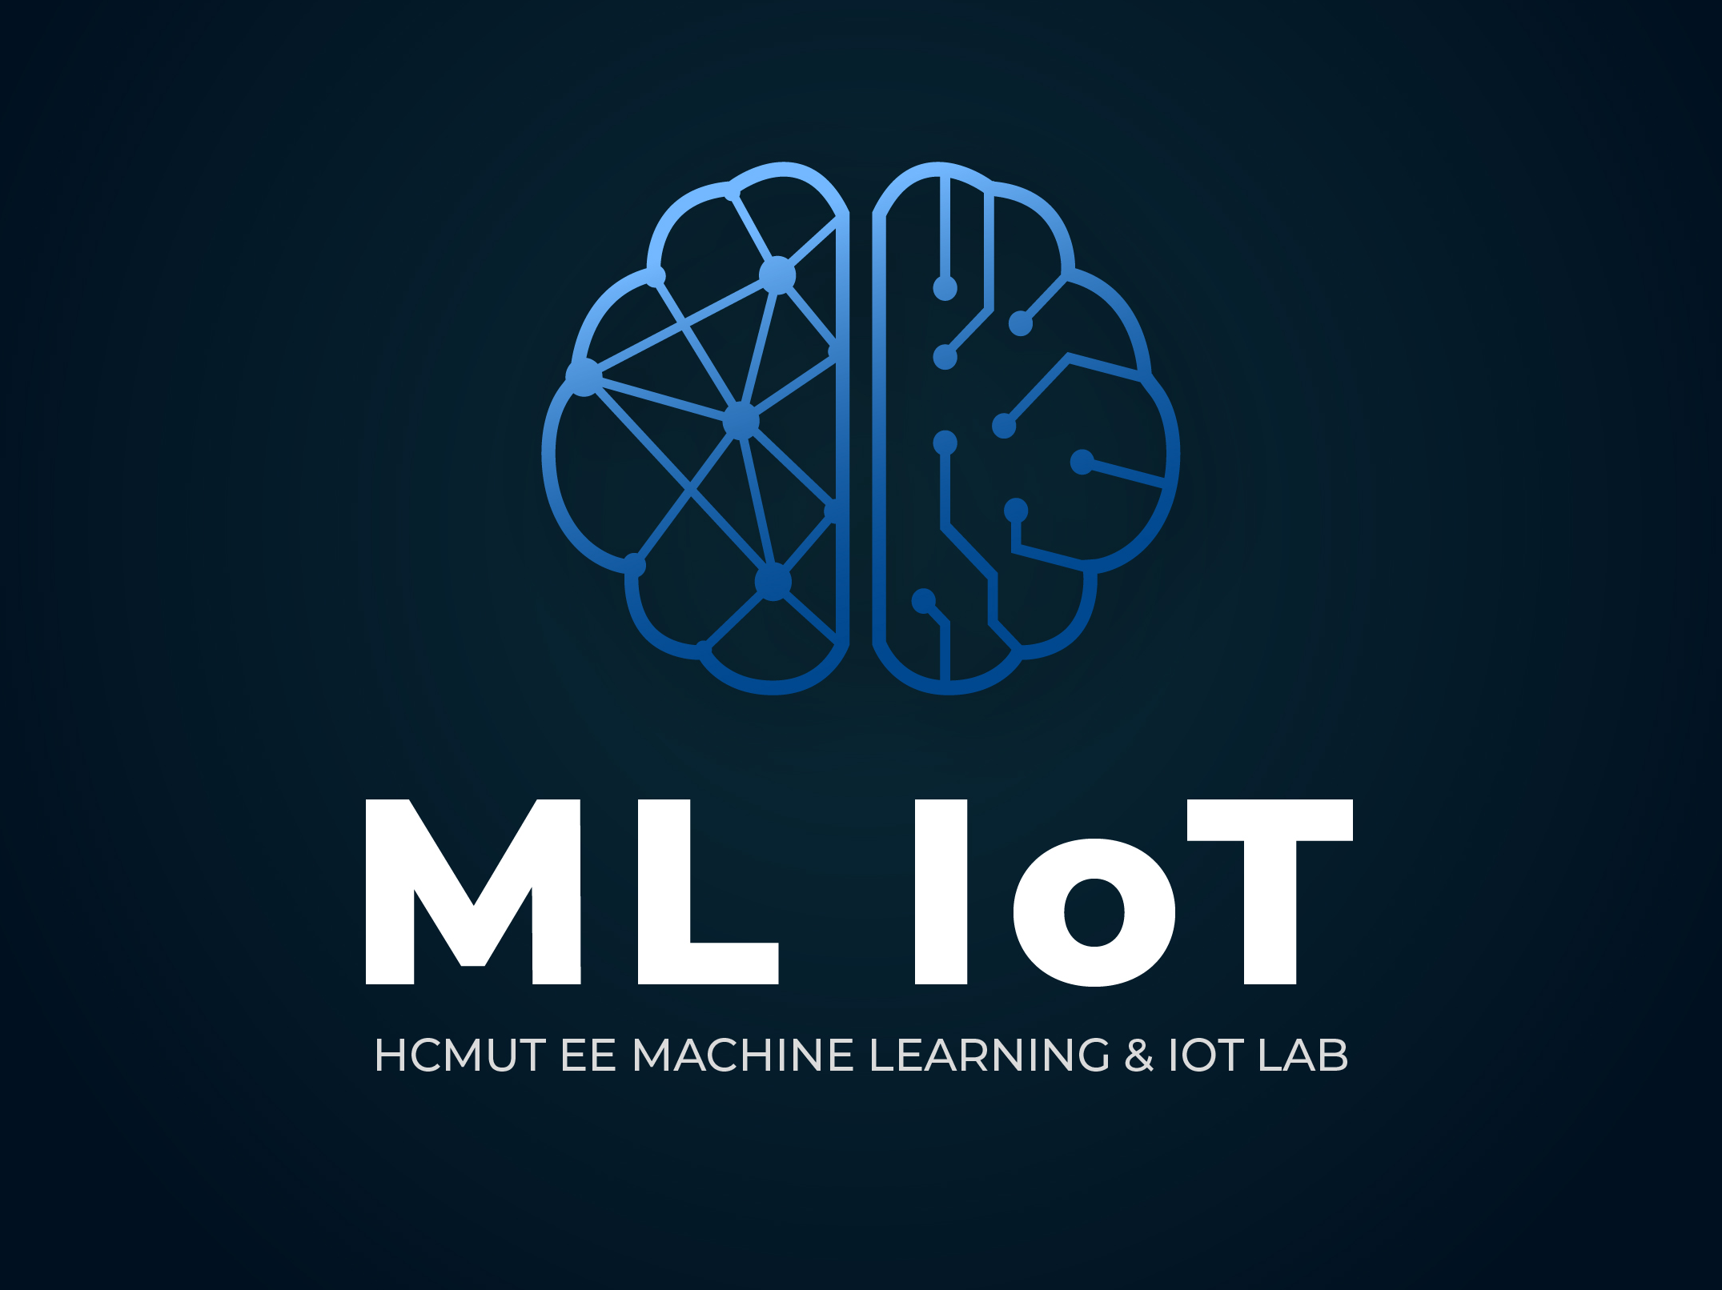
https://www.facebook.com/hcmut.ml.iot.lab
Kmeans, KNN, SVM
4/2021

Slide 2
Nội dung
K-means
KNN
SVM
Mathematics for Machine Learning
2
Nguyen Le Kim

Slide 3
KNN
K-nearest neighbor
K-means
3
Nguyen Le Kim

Slide 4
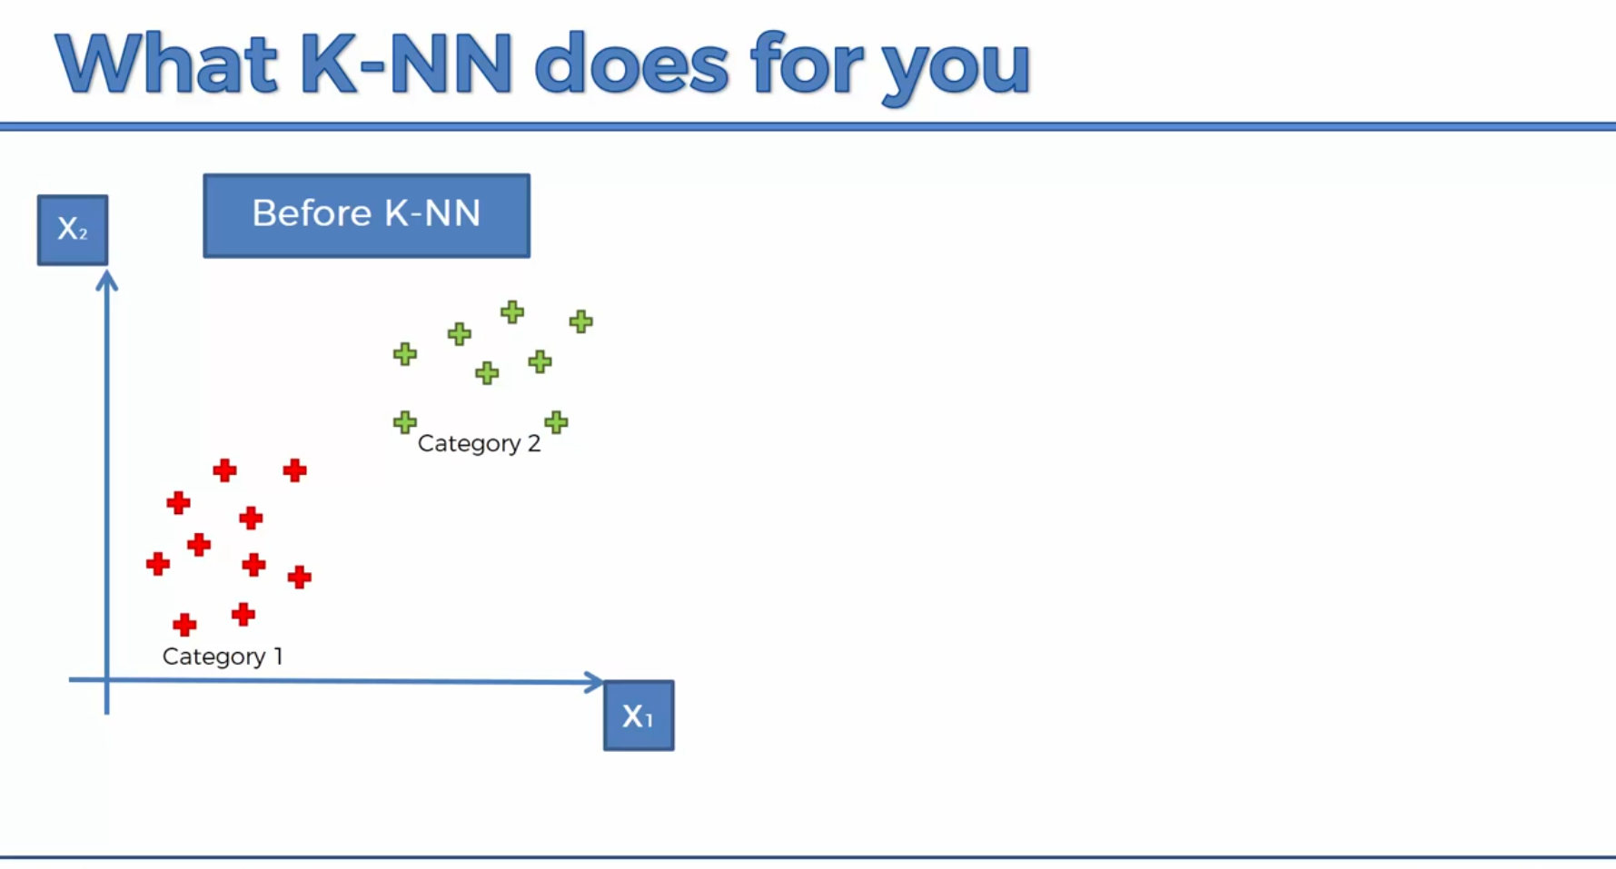
KNN
K-means
4
Nguyen Le Kim

Slide 5

KNN
K-means
4
Nguyen Le Kim

Slide 6
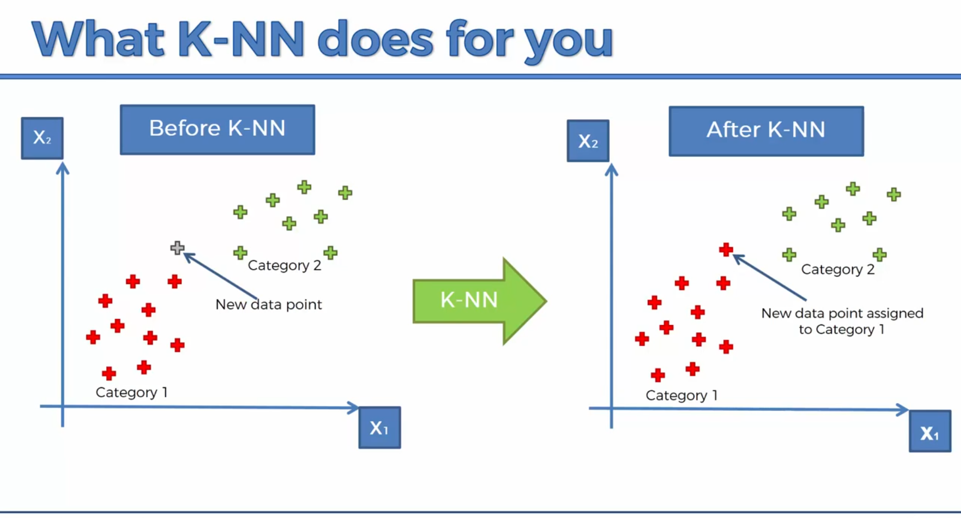
KNN
K-means
4
Nguyen Le Kim

Slide 7
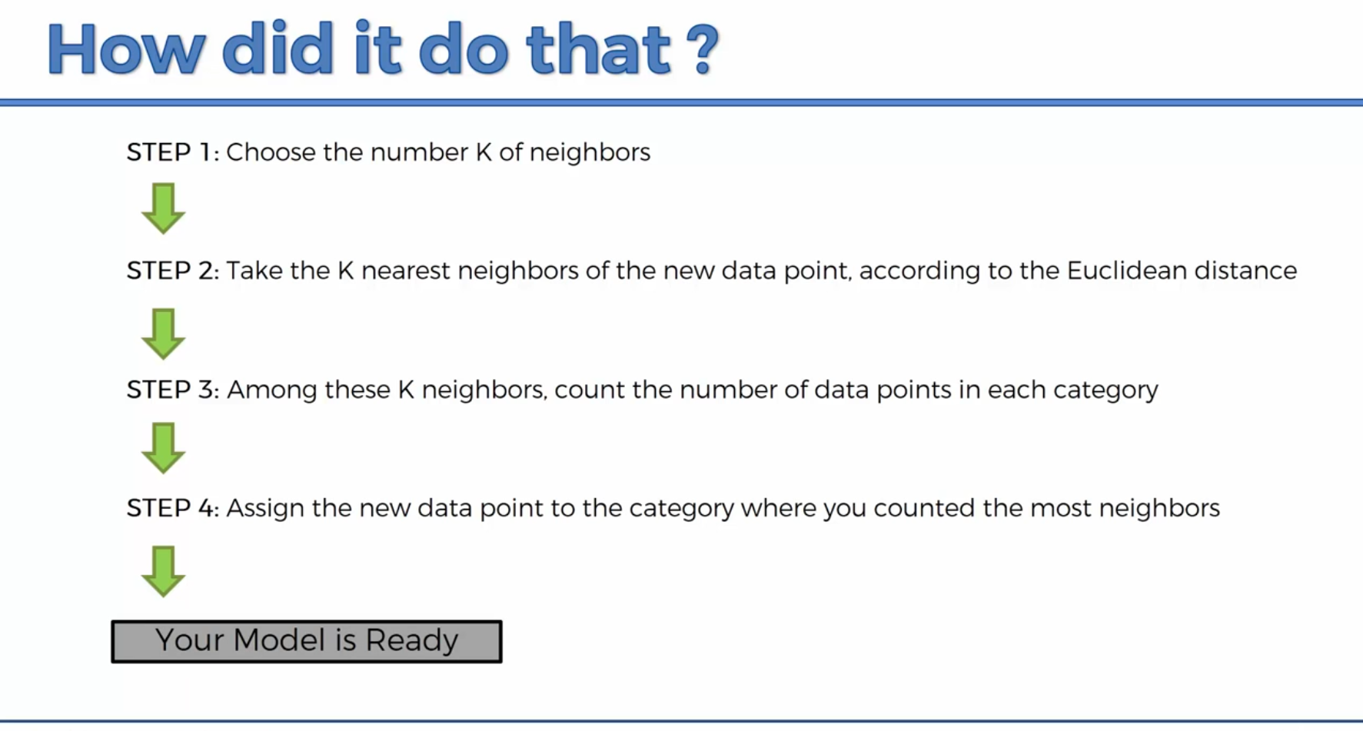
KNN
K-means
4
Nguyen Le Kim

Slide 8
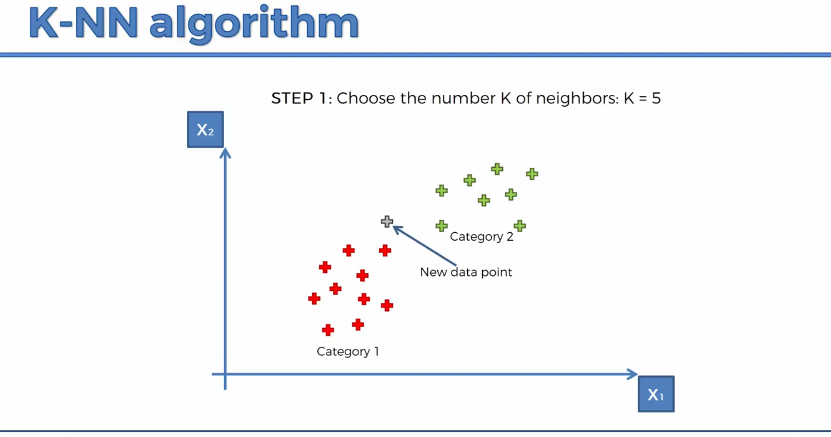
KNN
K-means
4
Nguyen Le Kim

Slide 9
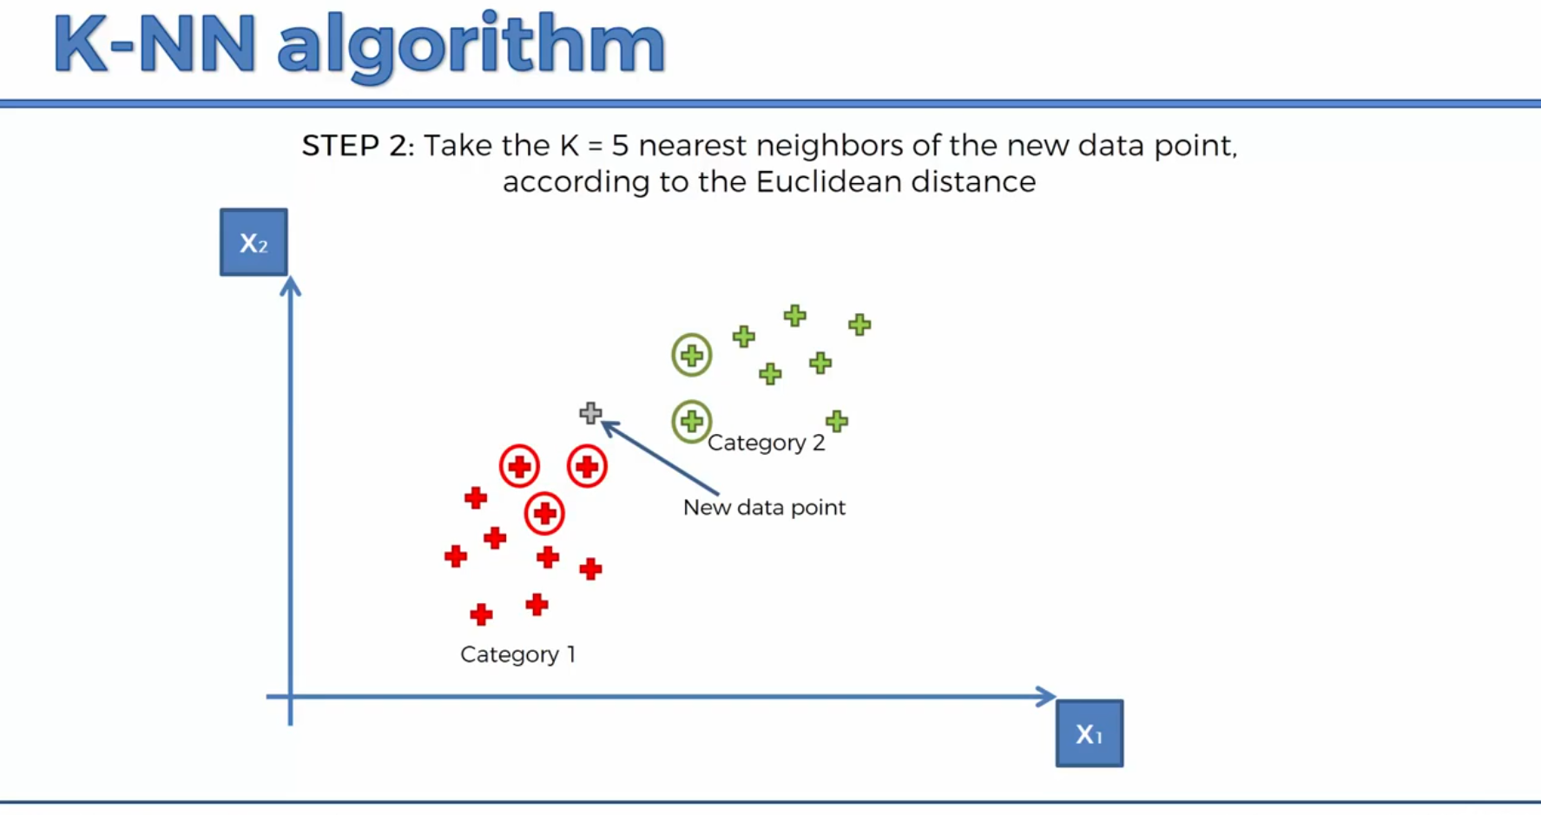
KNN
K-means
4
Nguyen Le Kim

Slide 10
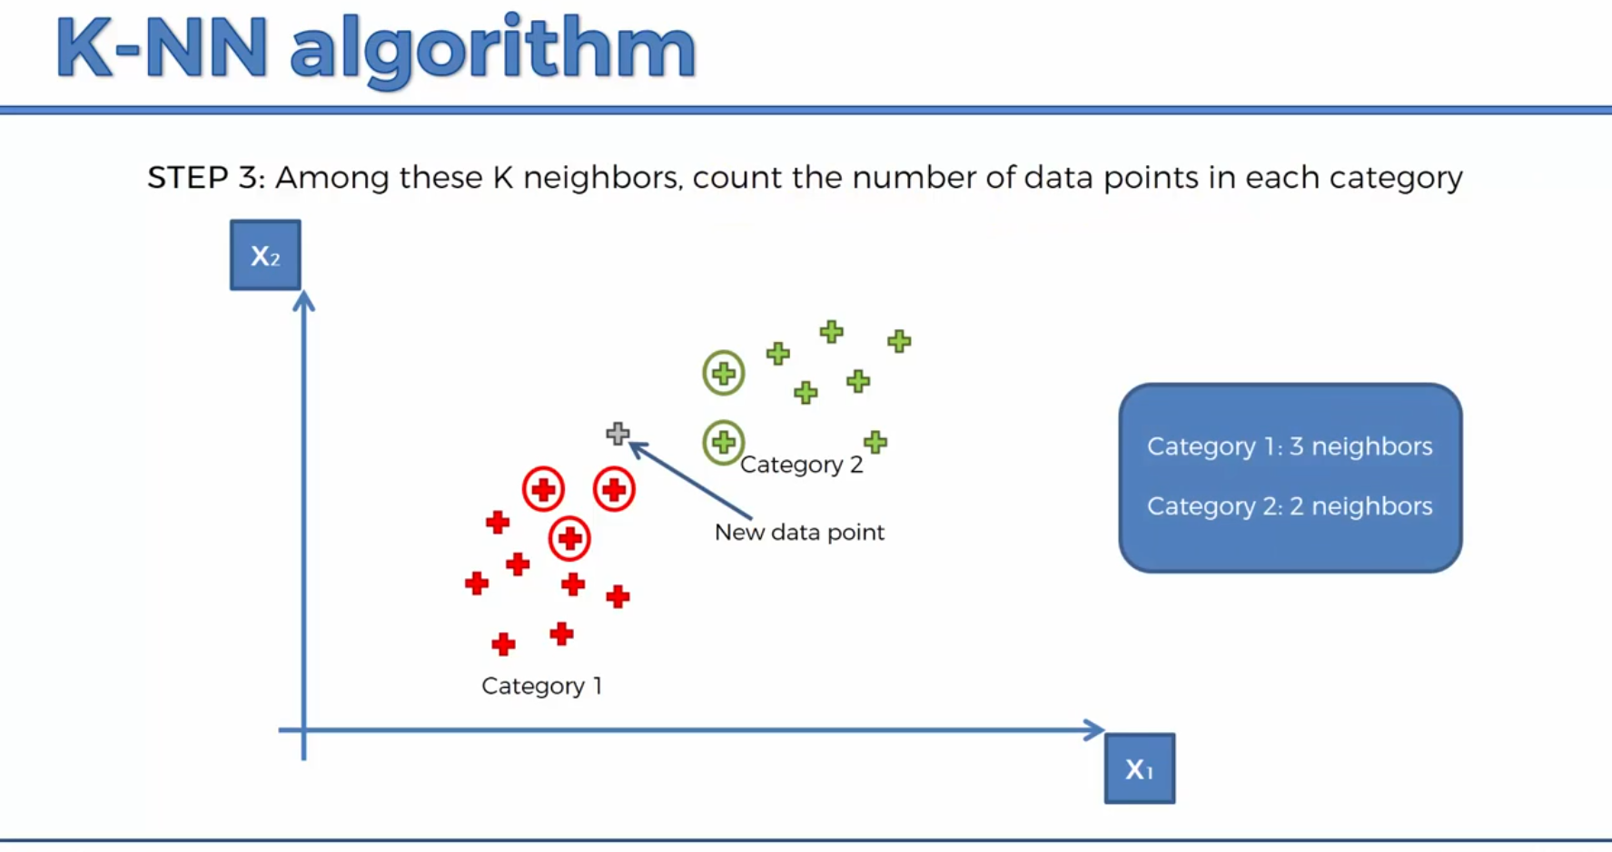
KNN
K-means
4
Nguyen Le Kim

Slide 11

KNN
K-means
4
Nguyen Le Kim

Slide 12
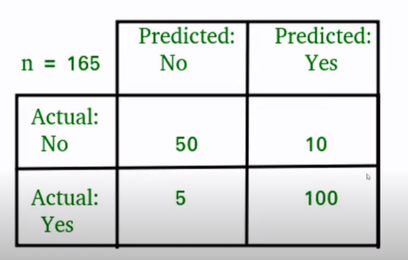
KNN
K-means
4
Nguyen Le Kim

Slide 13
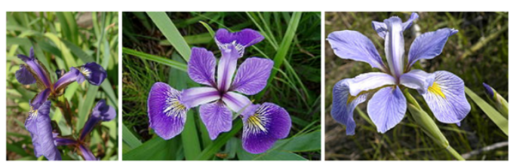
KNN
K-means
4
Nguyen Le Kim

Slide 14
SVM
(Support vector machine)
K-means
3
Nguyen Le Kim

Slide 15
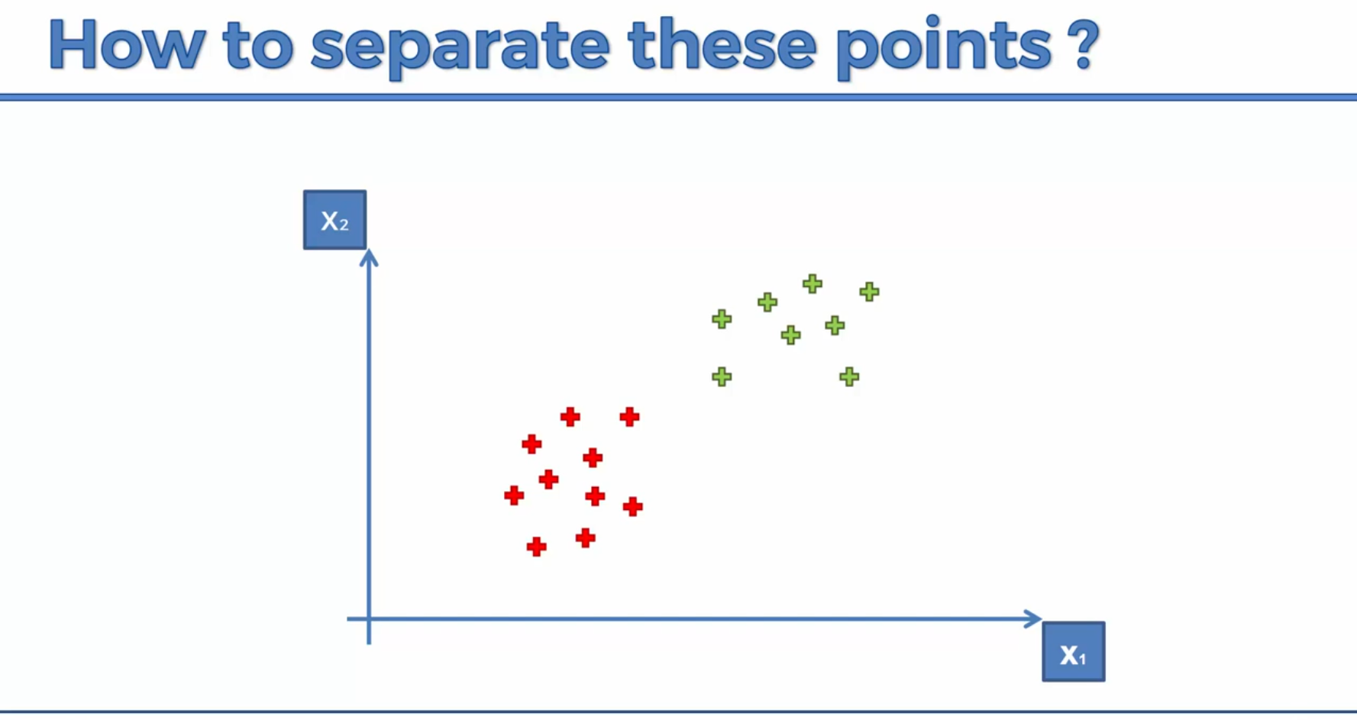
SVM
K-means
4
Nguyen Le Kim

Slide 16

SVM
K-means
4
Nguyen Le Kim

Slide 17
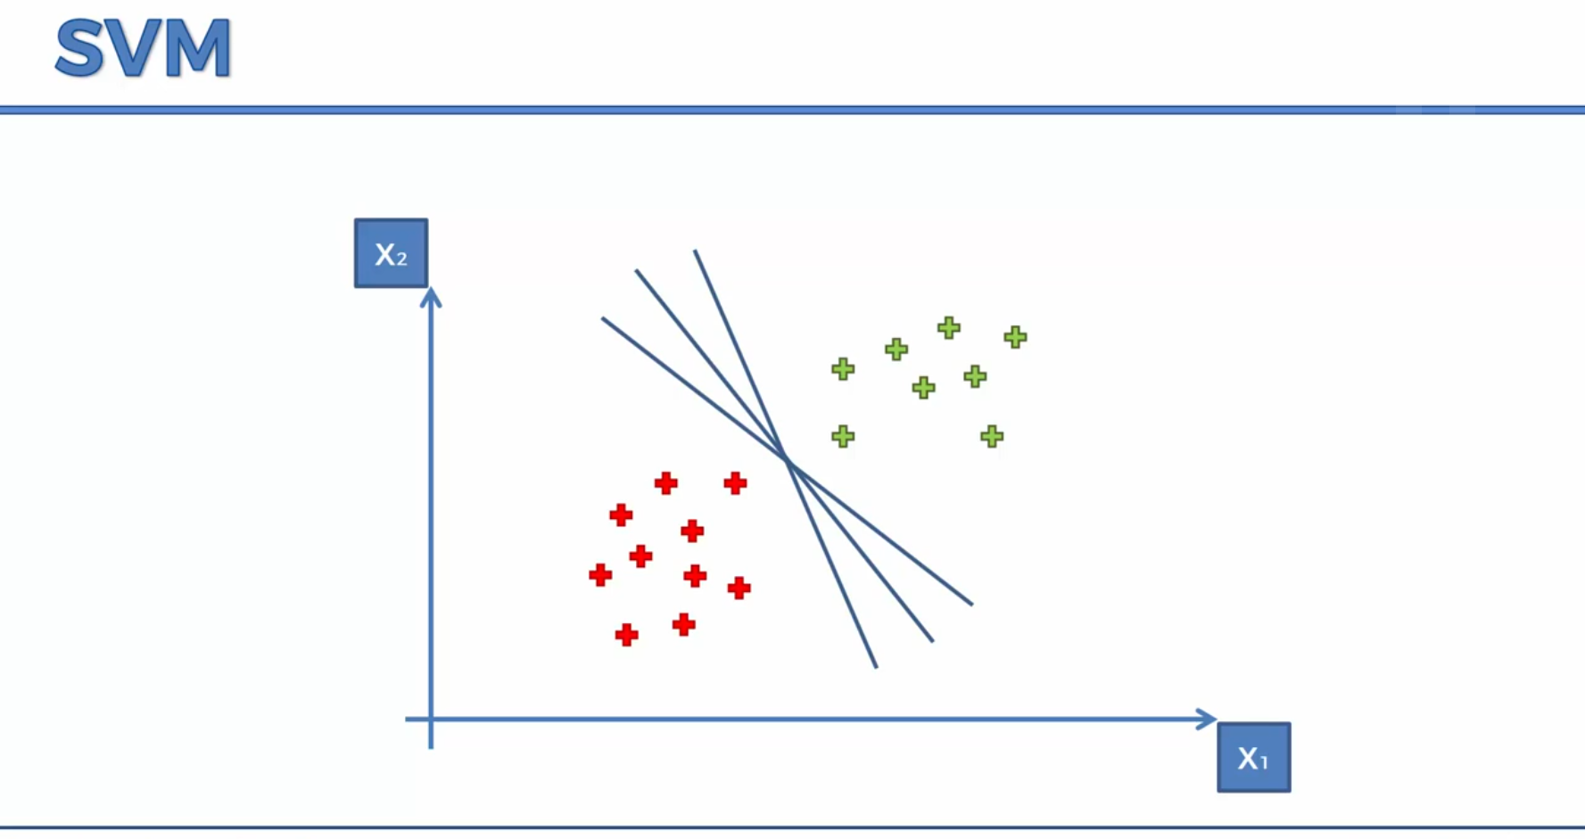
SVM
K-means
4
Nguyen Le Kim

Slide 18
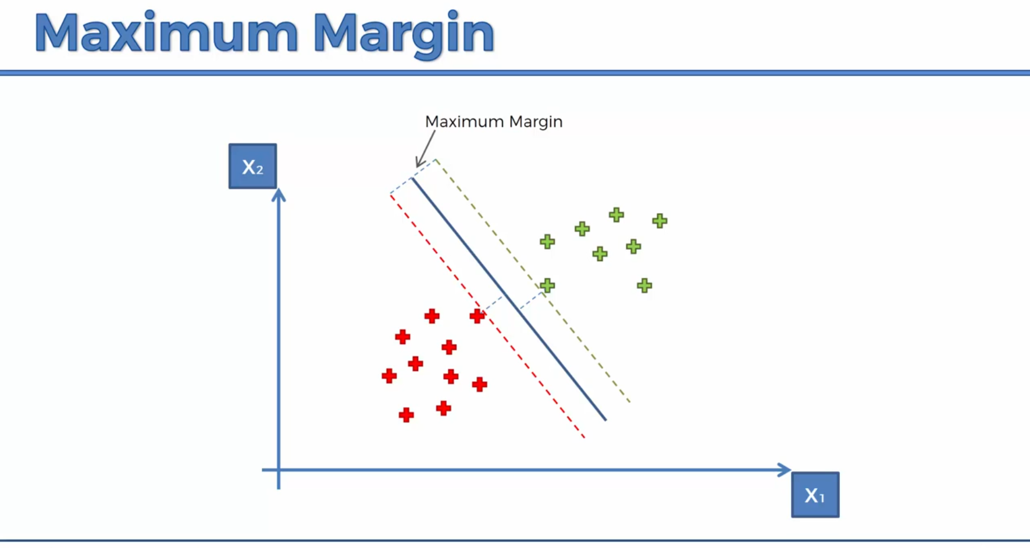
SVM
K-means
4
Nguyen Le Kim

Slide 19
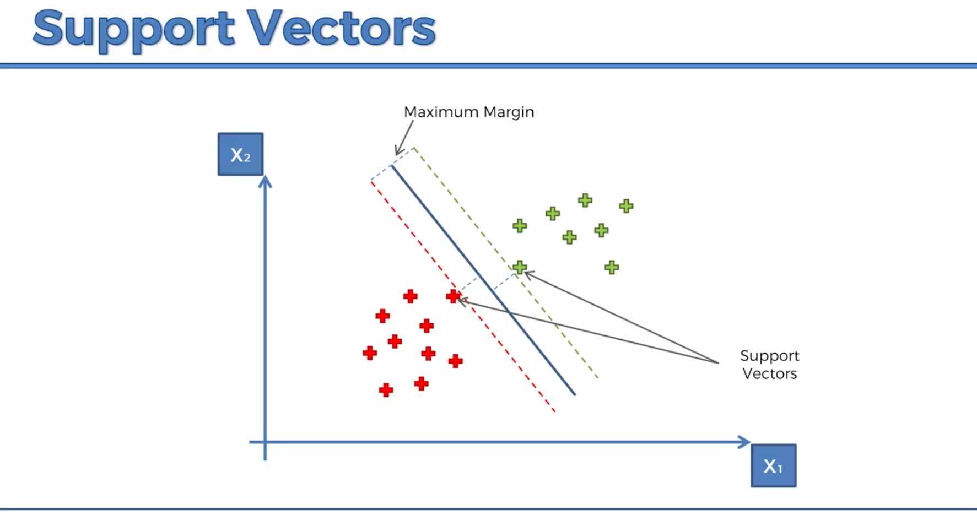
SVM
K-means
4
Nguyen Le Kim

Slide 20
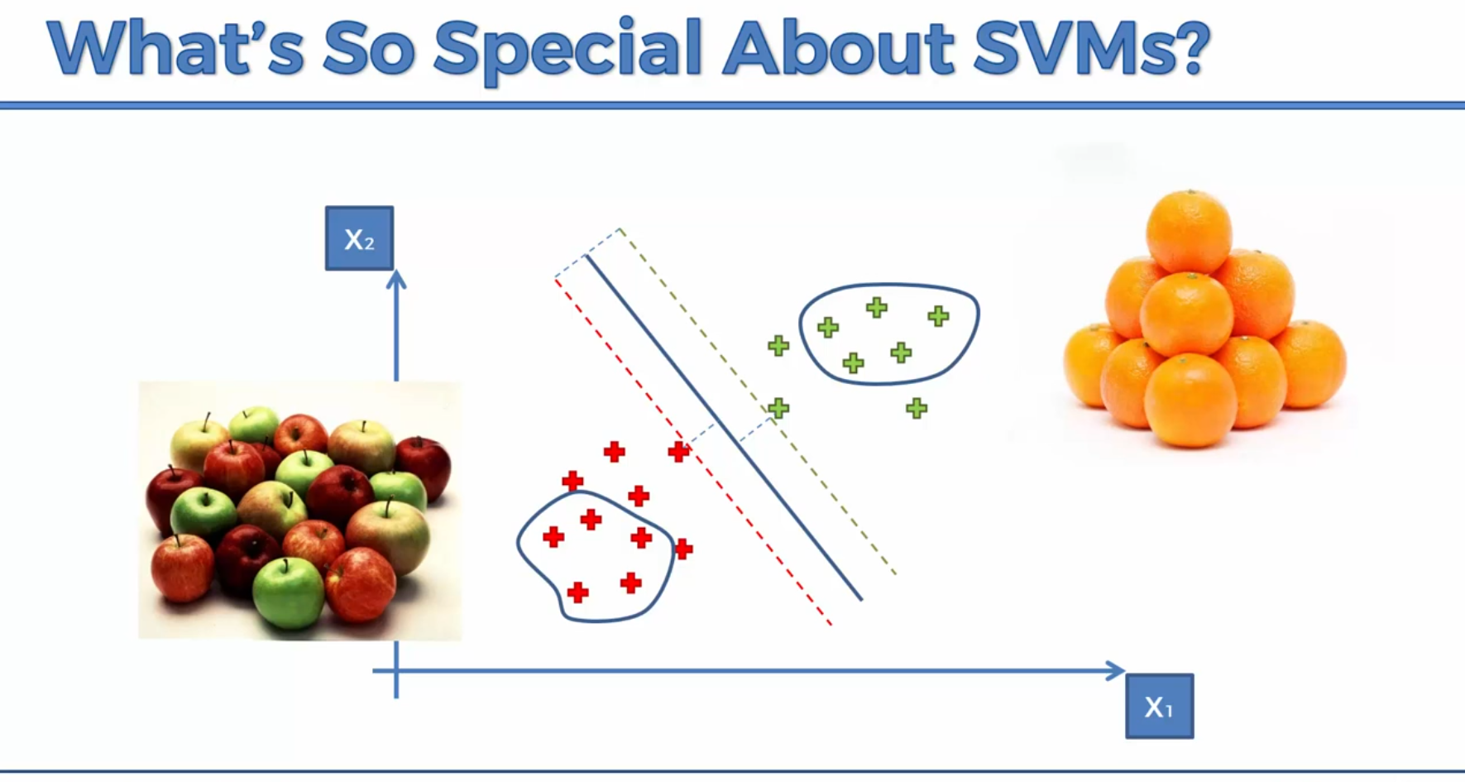
SVM
K-means
4
Nguyen Le Kim

Slide 21
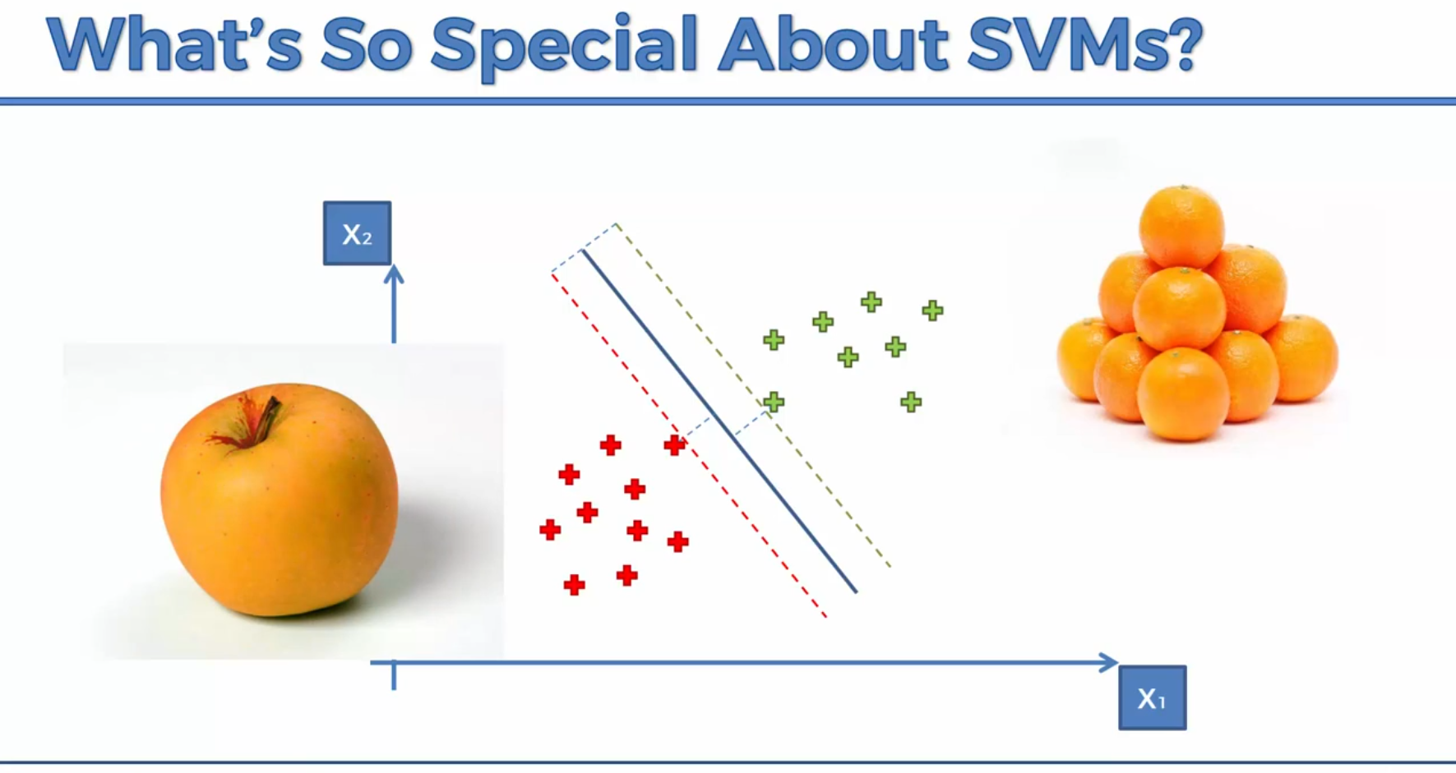
SVM
K-means
4
Nguyen Le Kim

Slide 22
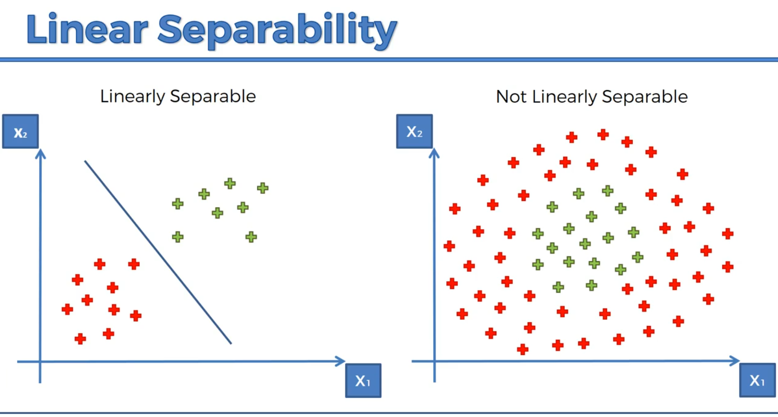
SVM
K-means
4
Nguyen Le Kim

Slide 23
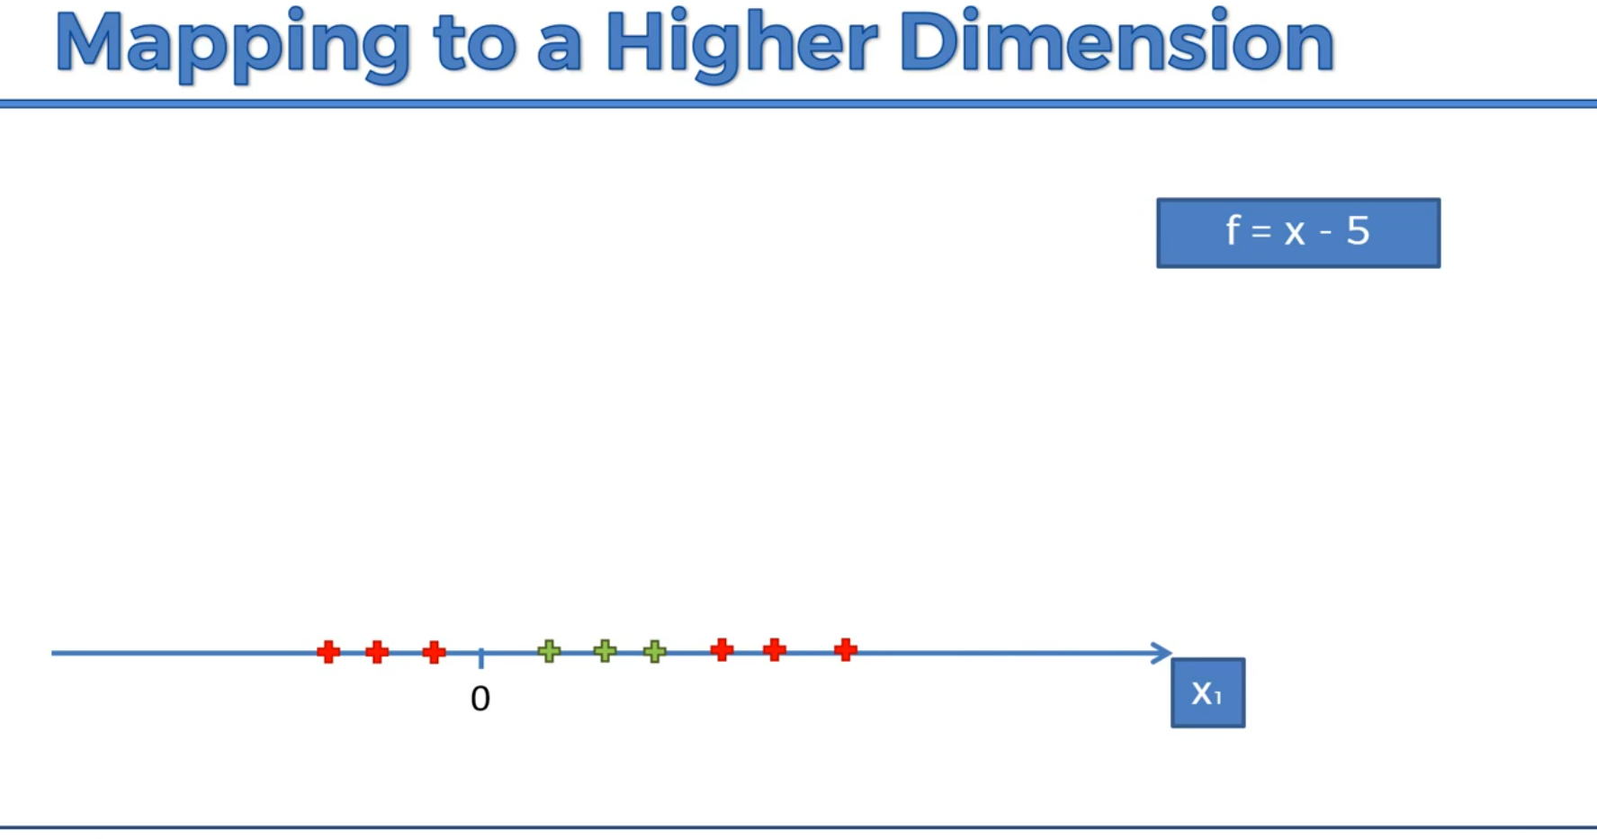
SVM
K-means
4
Nguyen Le Kim

Slide 24
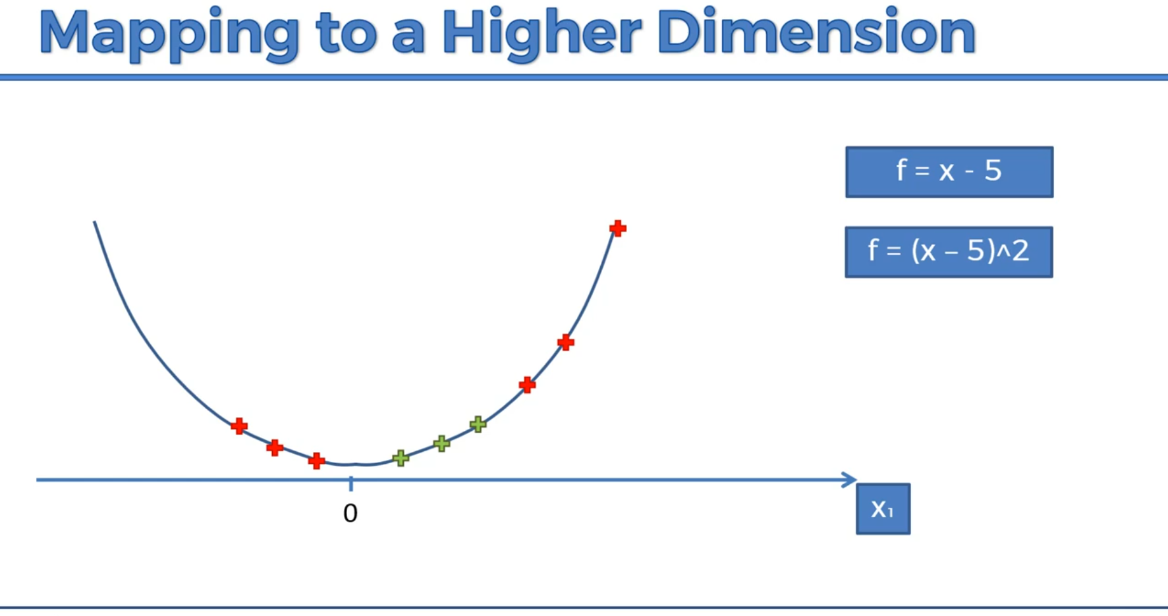
SVM
K-means
4
Nguyen Le Kim

Slide 25
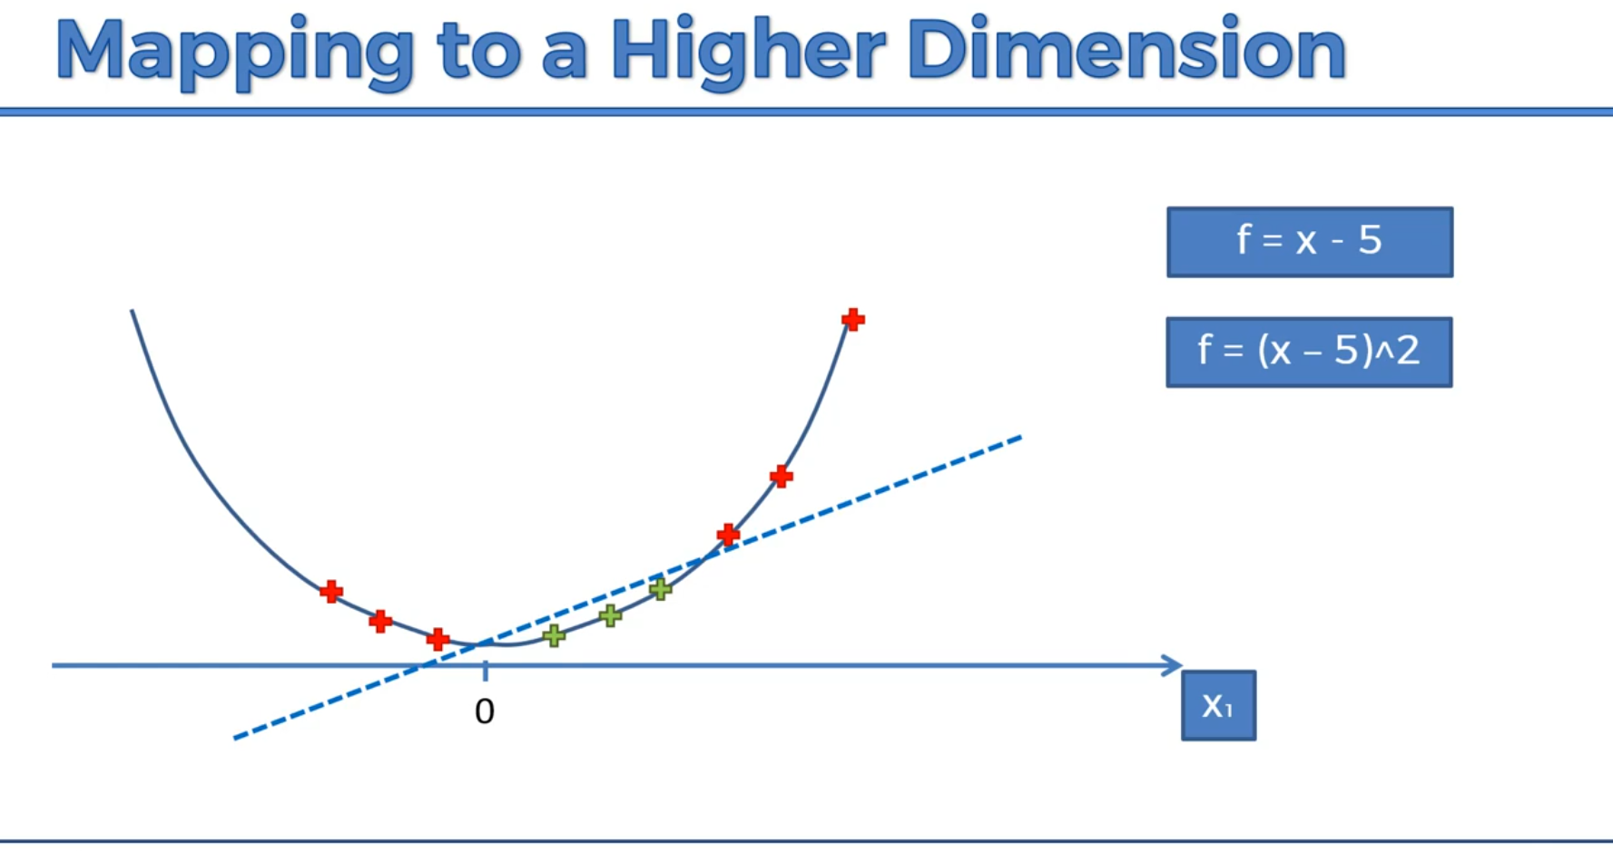
SVM
K-means
4
Nguyen Le Kim

Slide 26
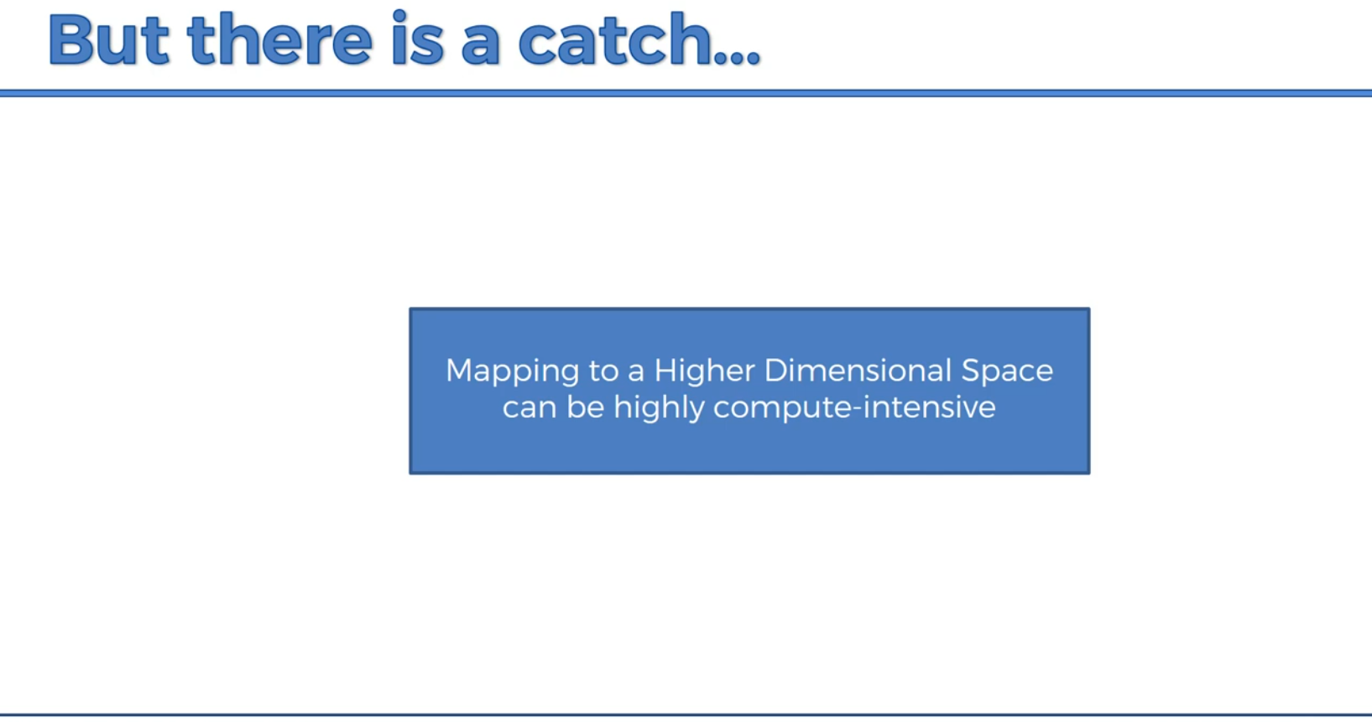
SVM
K-means
4
Nguyen Le Kim

Slide 27
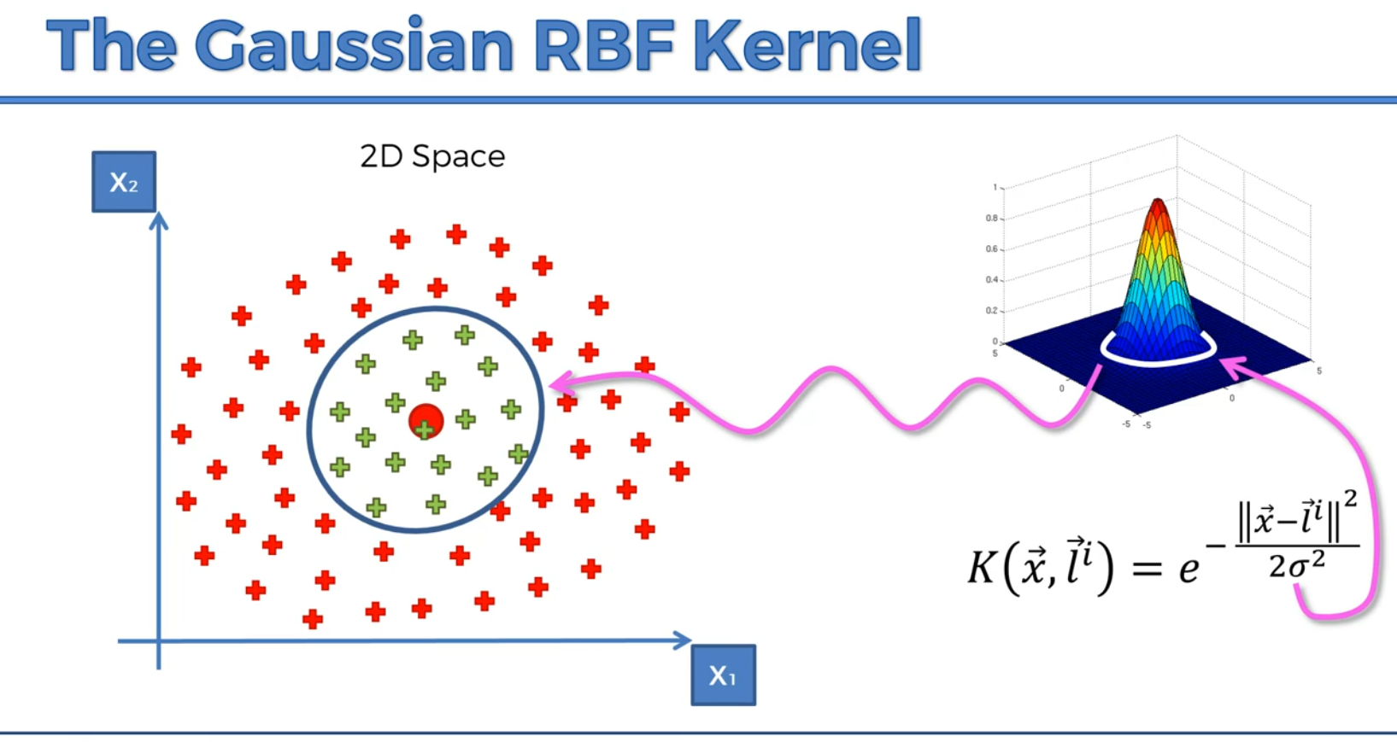
SVM
K-means
4
Nguyen Le Kim

Slide 28
K-means
4
Nguyen Le Kim

